Slide 1

AA-5750 Contemporary Issues in Analytics
Instructor: Chandra Prakash Bathula
Location : Xavier Hall G08
Timings: Monday & Wednesday | 9:00 Am – 10:50 AM

Slide 2
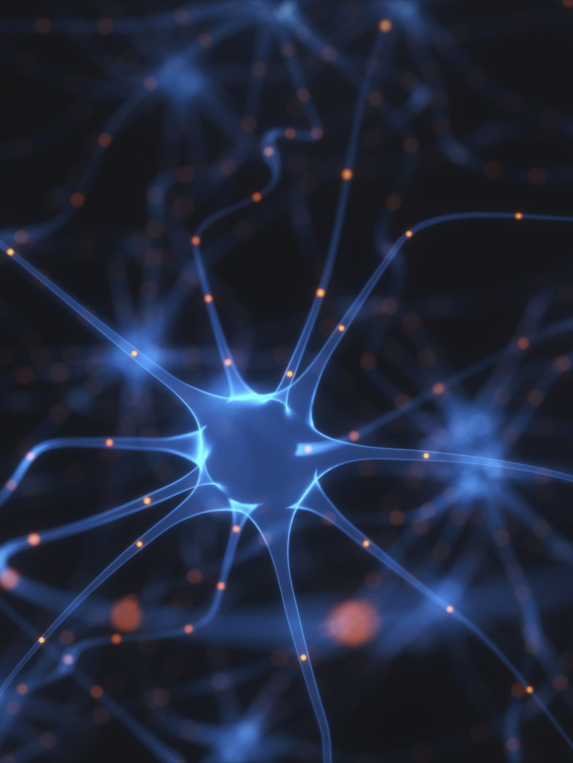
Week – 1 Agenda
How computers learn patterns — Machine Learning overview
Real-world applications
Types of Machine Learning
Classical Machine Learning limitations
Importance of non-linearity
Neural Networks and their biological inspiration
Perceptron and step function
Activation functions — Sigmoid, Tanh, ReLU
Multi-Layer Perceptron
Backpropagation
Numerical example for binary classification

Slide 3
How can computers learn patterns from data?
House Price Prediction: Learn from past sales data to estimate future prices based on location, size, bedrooms
Spam Email Detection: Identify spam patterns from millions of labeled emails (Google filters 100M+ spam emails daily)
Face Recognition: Detect facial features across millions of images (powers iPhone Face ID, Facebook tagging)
Disease Diagnosis: Analyze medical scans to detect cancer earlier than human radiologists (FDA-approved AI for 200+ conditions)
Computers discover patterns automatically from examples → This is Machine Learning

Slide 4
What is Machine Learning?
Traditional Programming | Machine Learning
Rules + Data → Output Human writes explicit if-then rules | Data + Output → Rules Computer discovers patterns automatically.
Example: Spam filter with 100 hand-coded rules. | Example: Gmail learns from 1B+ emails what spam looks like.
Machine Learning (ML) is a subset of AI where computers learn patterns directly from data.
Difference between Traditional Programming vs Machine Learning:
Instead of programming every rule, ML algorithms analyze examples to generalize.

Slide 5
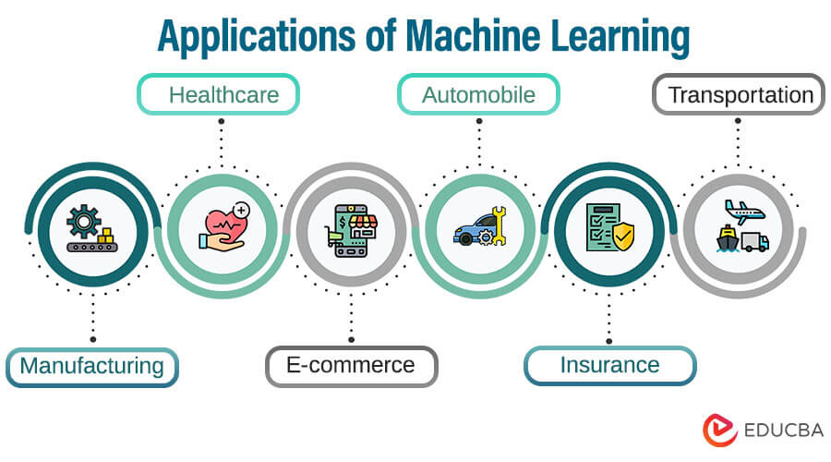
Real-World ML Applications.
ML powers $500B+ industries with massive impact:
Healthcare
Disease prediction: AI matches specialists across 20+ conditions.
Medical imaging: FDA-approved for 200+ conditions, detects cancer earlier than radiologists.
Finance
Fraud detection: $3.7T annual cost; 90% banks use AI (50% for scam detection).
Risk modeling: American Express improved fraud detection 6% with LSTM models.
Technology
Recommendation systems: Netflix personalization drives 80% of viewing.
Voice assistants: Powers Siri, Alexa, Google Assistant.
Autonomous Systems
Self-driving cars: Waymo 200M+ autonomous miles, 10 cities, ~1M rides/week.
Impact: ML processes 2.5 quintillion bytes of data daily across these domains.

Slide 6
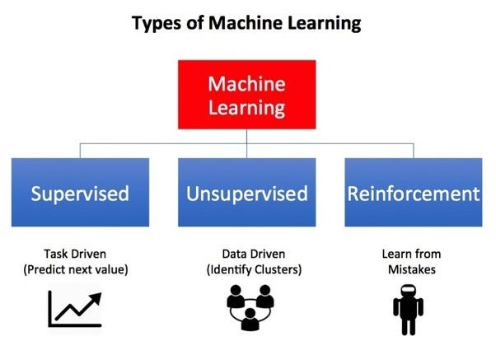
Types of Machine Learning
Three core paradigms power modern ML systems:
Supervised Learning
Labeled data: Input + correct output provided during training.
House price prediction: Train on 1M+ homes (size → $275K) to predict new listings.
Other examples: Email spam (95% accuracy), cancer diagnosis from scans.
Unsupervised Learning
No labels: Algorithm discovers hidden patterns automatically.
Customer segmentation: Groups 100M shoppers into 5 behavior clusters for targeted marketing.
Other examples: Fraud anomaly detection, market basket analysis.
Reinforcement Learning
Trial & error: Agent maximizes rewards through environment interaction.
Game AI: AlphaGo beat world champion (1.6M simulations/second).
Other examples: Self-driving cars, robotic surgery, stock trading.
Type | Data | Goal | Key Example
Supervised | Labeled | Predict outcomes | House prices
Unsupervised | Unlabeled | Find patterns | Customer groups
Reinforcement | Rewards | Optimize actions | Game AI

Slide 7

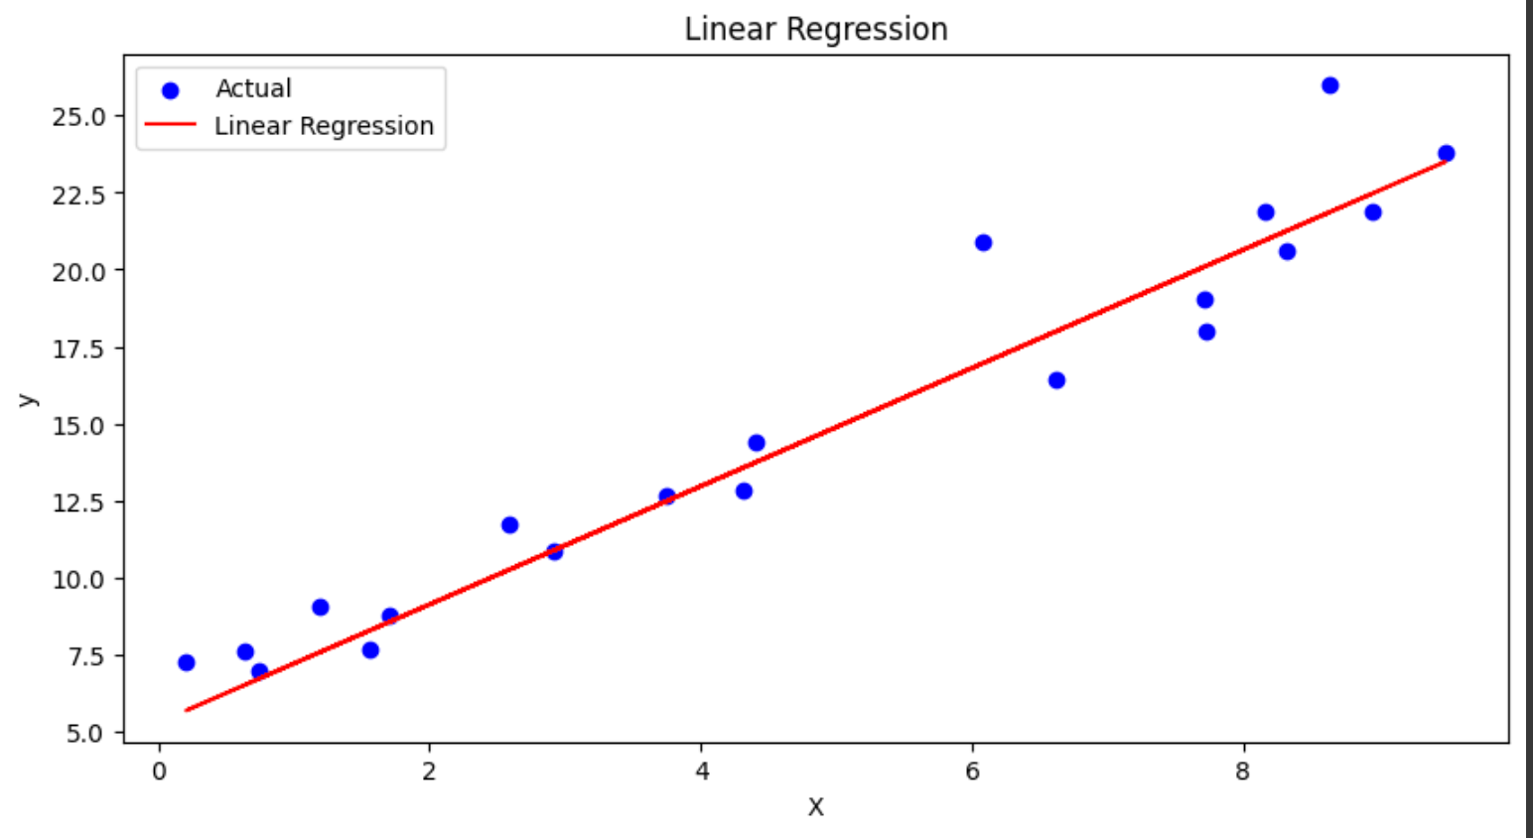
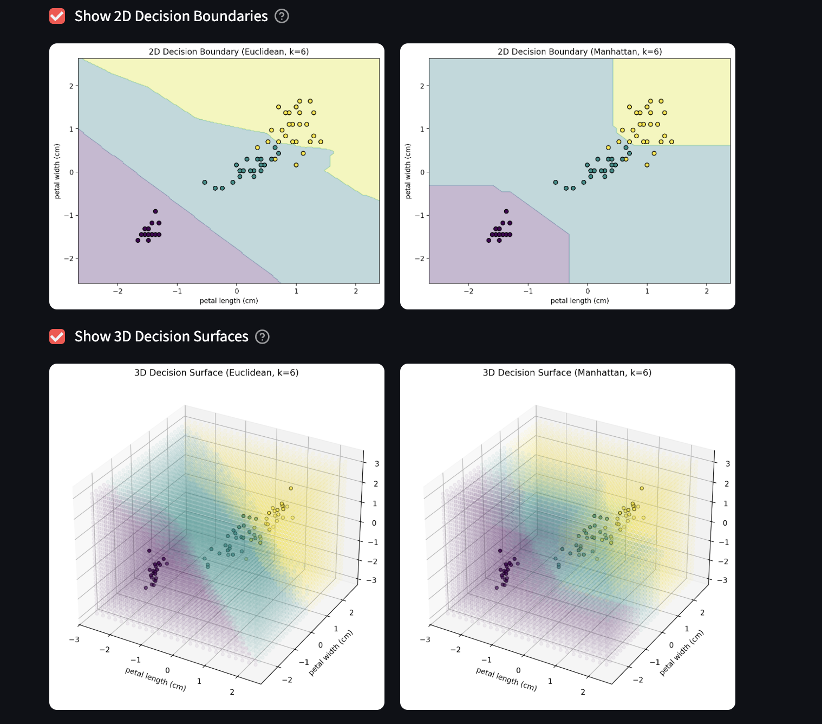
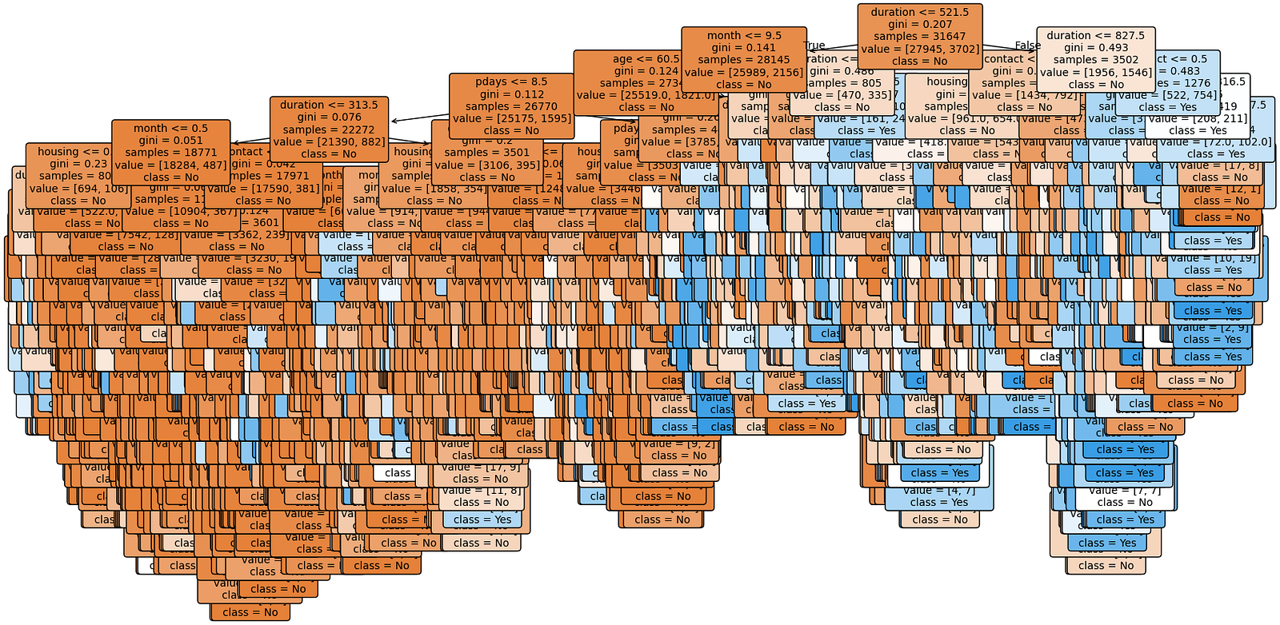
Classical Machine Learning
Purpose: Predict or classify using data patterns.
Algorithms:
  K-NN: Classifies by nearest neighbors (e.g., recommendations).
  Decision Trees: If-else rules (e.g., fraud detection).
  Logistic Regression: Linear boundaries (e.g., spam detection).
  SVM: Maximizes class margins (e.g., image classification).
  Naive Bayes: Probability-based (e.g., spam filters).
Core: Fits functions to predict new data.

Slide 8
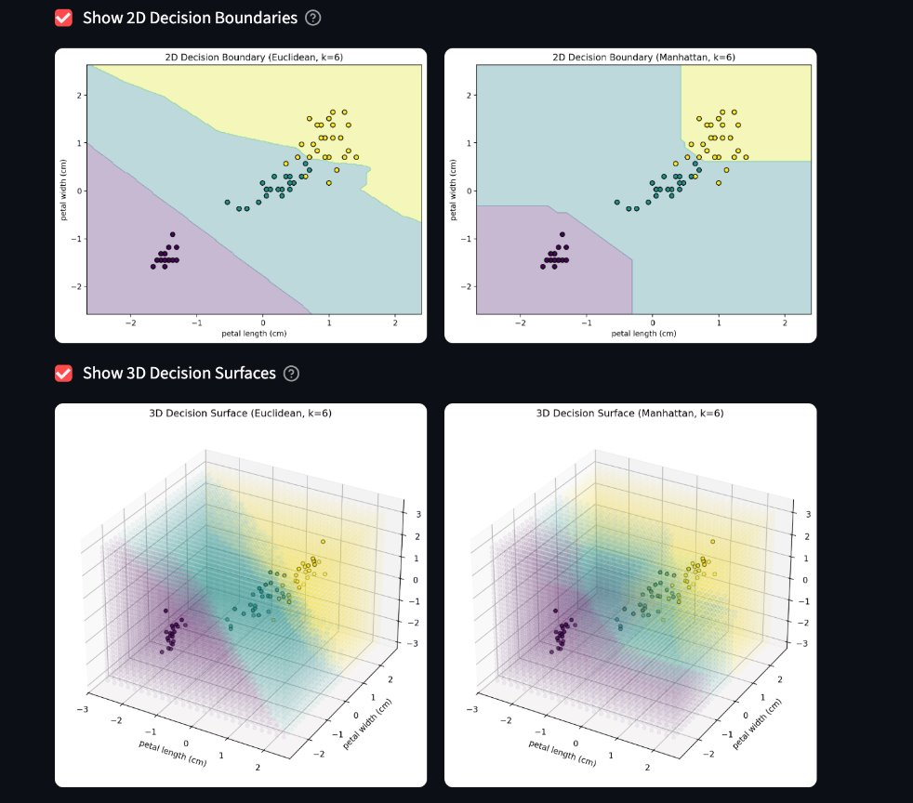
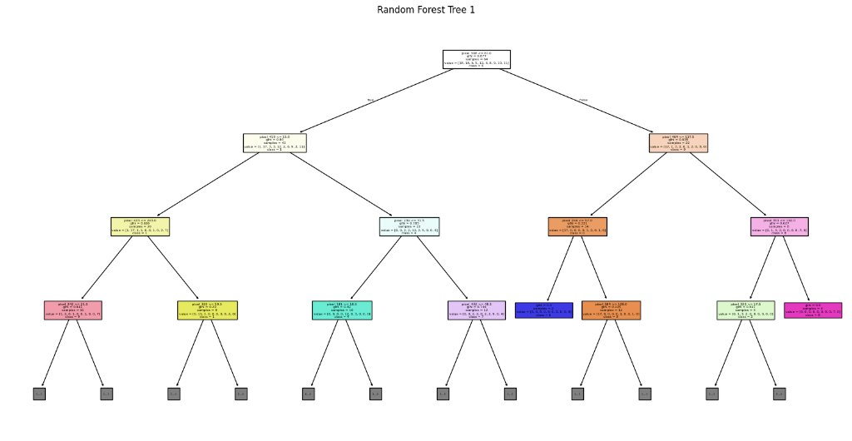
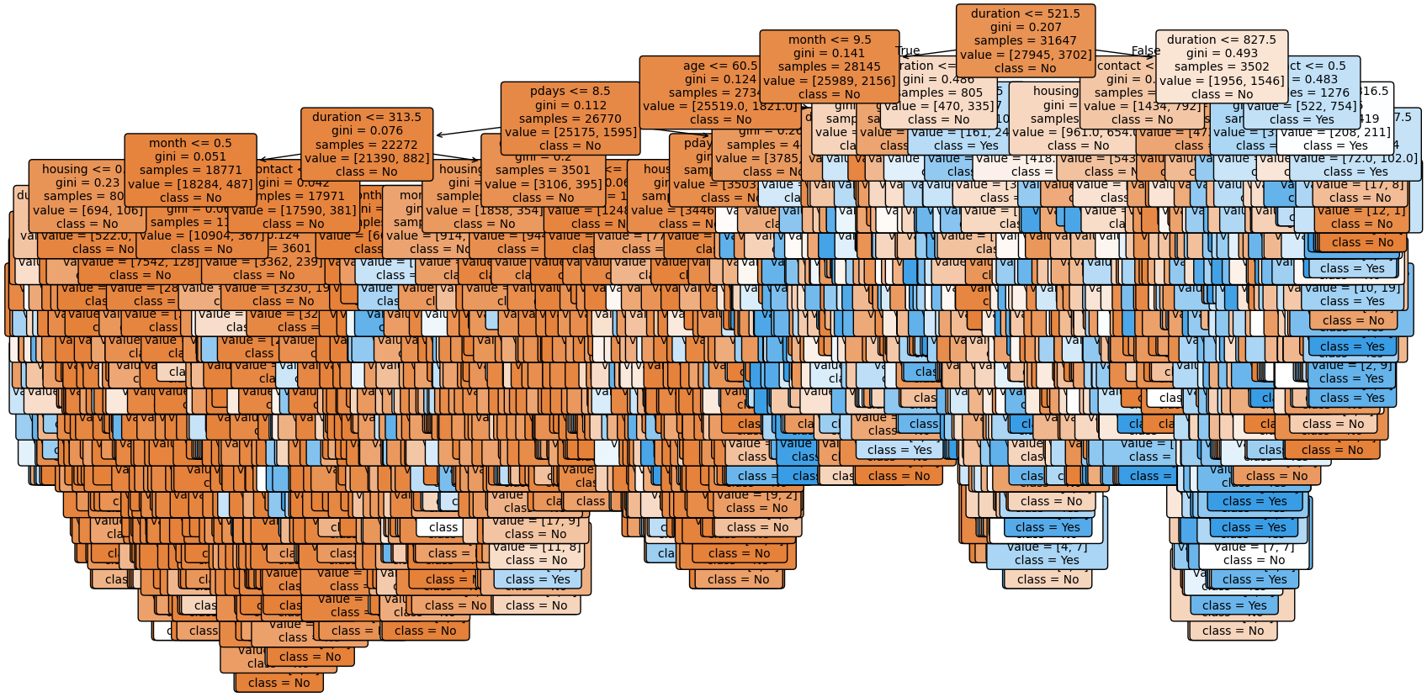
Classical ML
Examples of Classical ML Algorithms

Slide 9
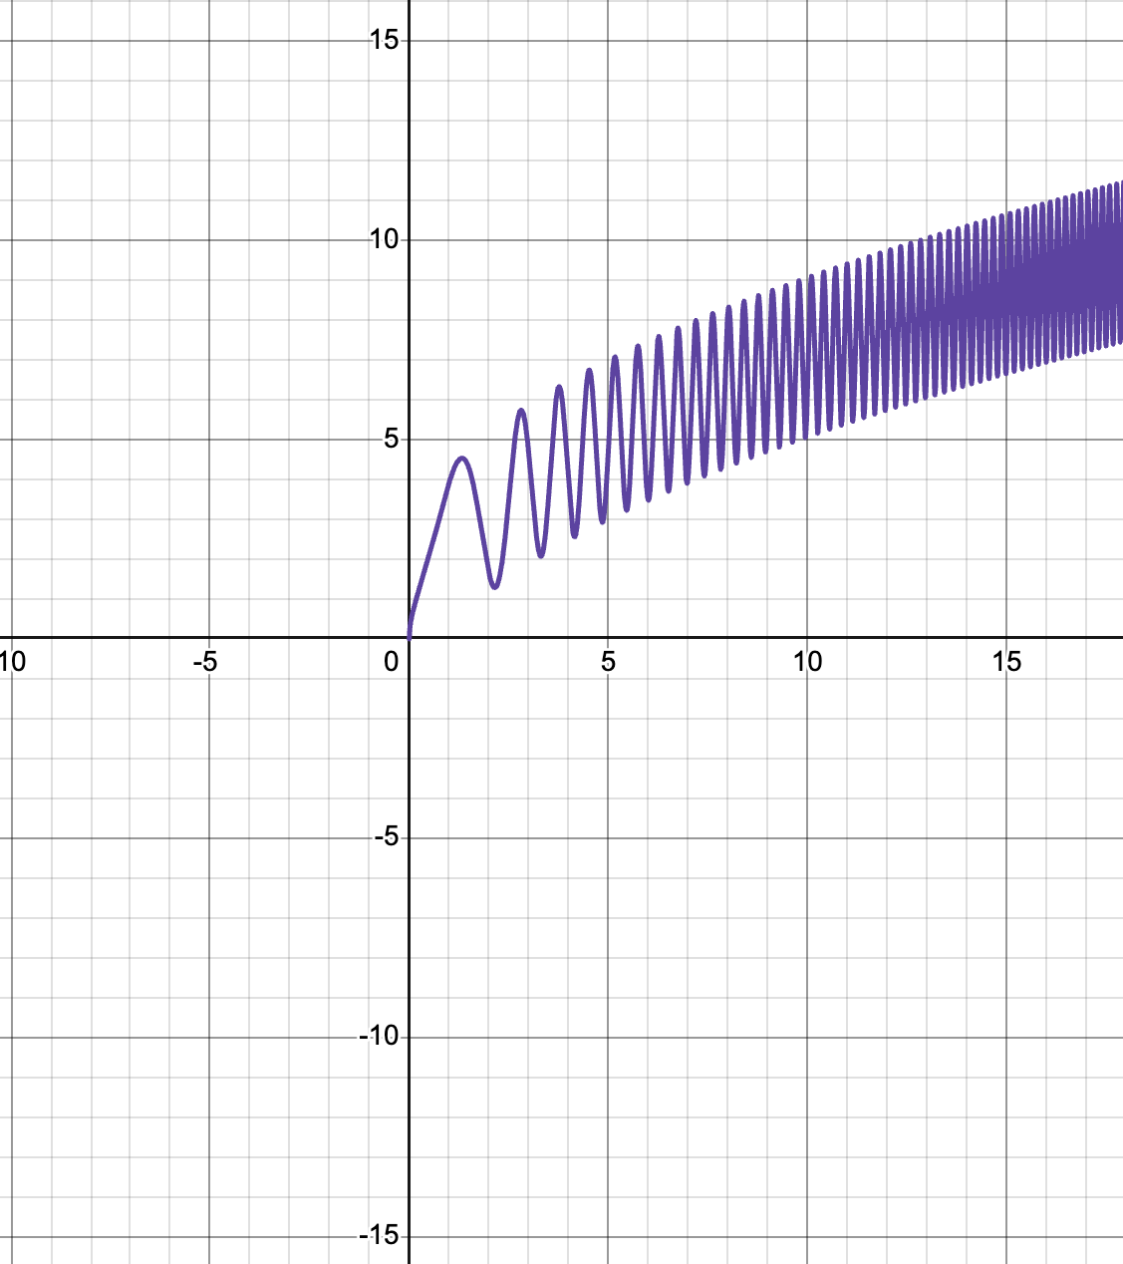
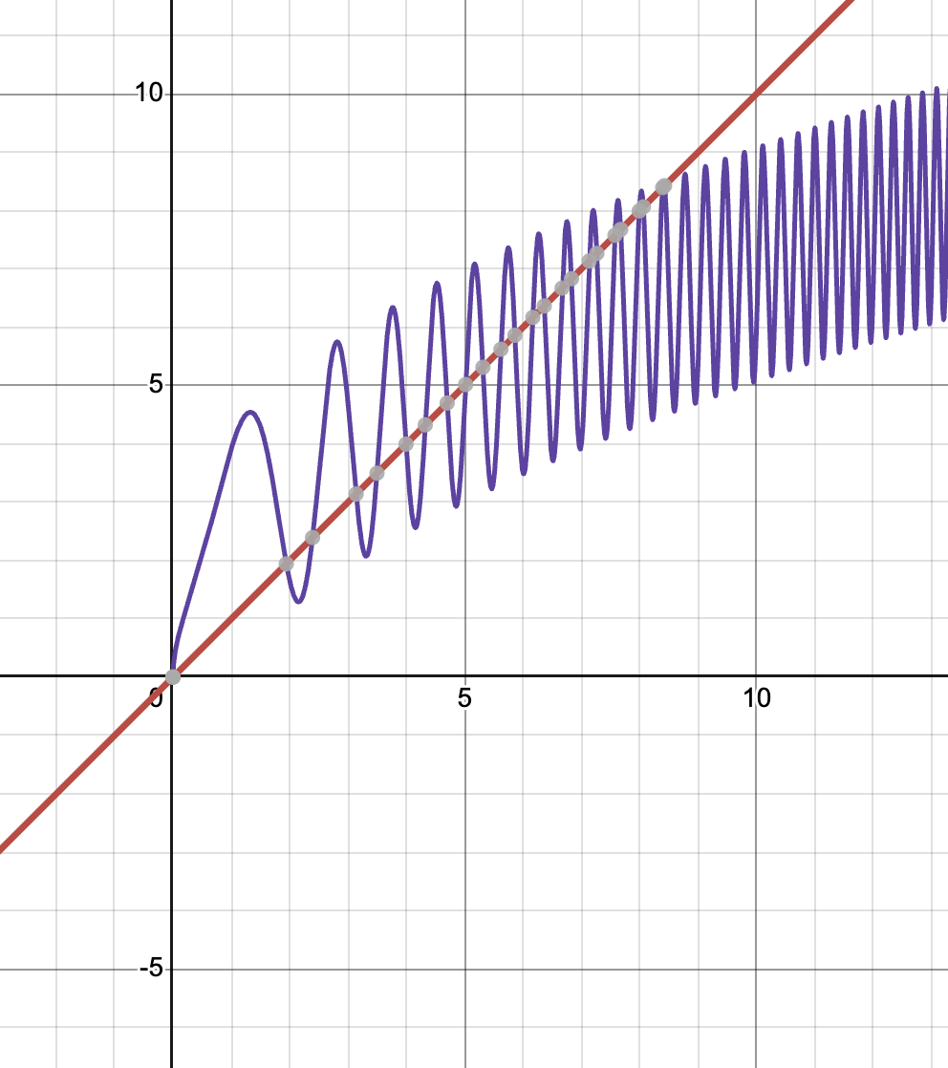
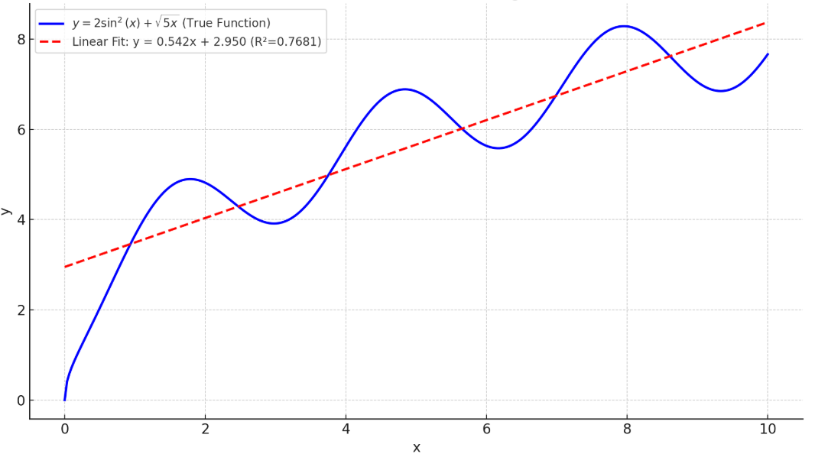
Importance of Non-Linearity
Why Needed? Linear models can’t capture complex patterns (e.g., XOR, circles, images).
Non-Linear Activations:
Enable complex decision boundaries.
Allow layers to build hierarchical features.
Impact: Makes deep networks universal approximators for any function.

Slide 10
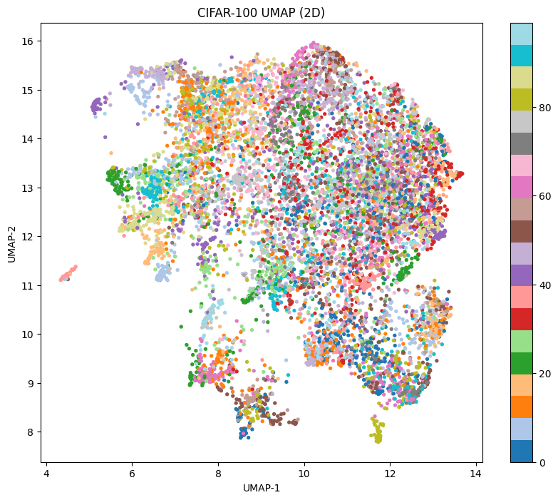
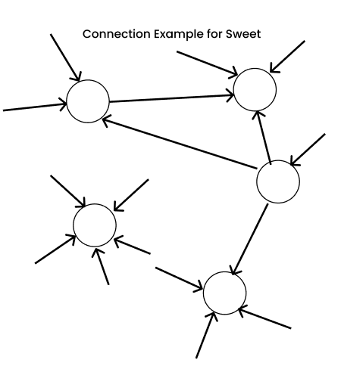
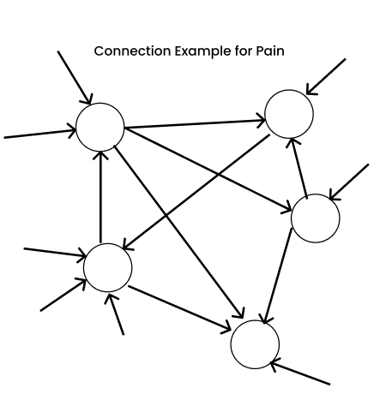
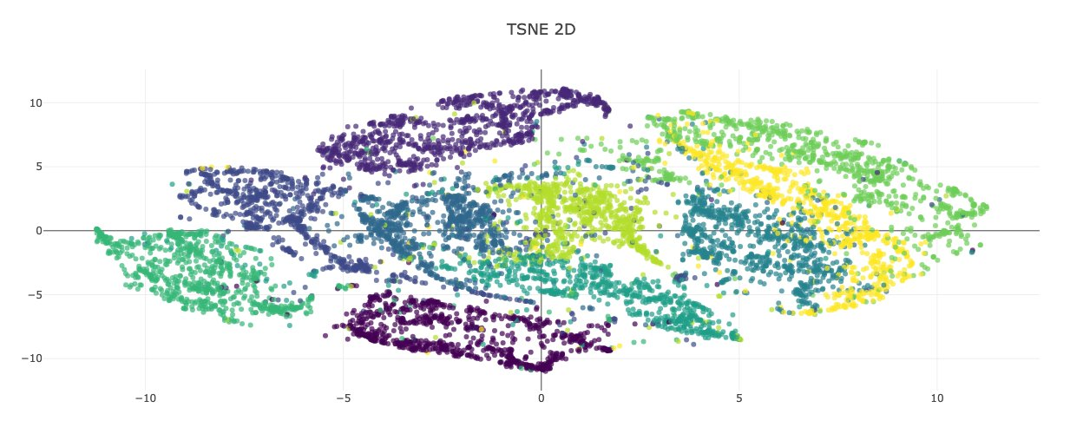
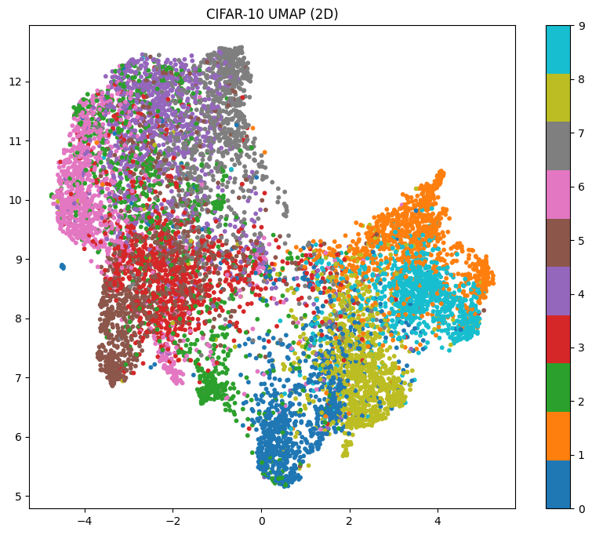

Slide 11
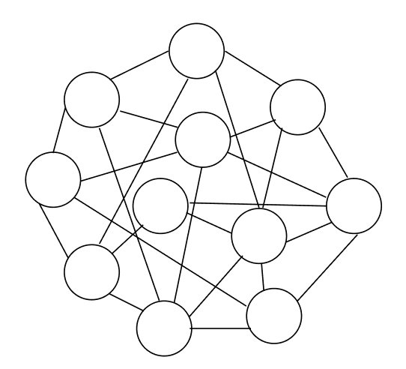
Why Neural Networks?
Traditional ML fails where complexity explodes:
The Complexity Problem:
Images: 224×224 pixels = 50K dimensions (SVM/kernel methods collapse)
Speech: 16KHz audio = millions of interdependent features per second
Language: Words form 10¹⁸ possible sentences (N-gram models can't scale)
Nonlinear data: Real patterns twist in high-dimensional space
Challenges: Classical ML excels with linear or structured data but struggles with non-linear patterns (e.g., XOR, images, speech).
Examples of Non-Linear Data:
XOR logic gate: Classes not separable by a line.
Images: Complex patterns like faces or objects.
Text: Hierarchical language structures.
Why It Matters: Non-linear data is common in real-world tasks, requiring more powerful models.
Neural Networks Solution:
Brain-inspired: 86B neurons process complex patterns effortlessly.
Hierarchical learning: Low-level features → High-level concepts.
End-to-end: Raw pixels → "cat" (no hand-engineered features needed).
Breakthrough: AlexNet (2012) crushed ImageNet competition by 10% using CNNs .
Note : Neural networks scale where traditional ML breaks.
Data Type | Traditional ML | Success Rate
Tabular (prices) | Decision Trees | 85-95%
Images | SIFT + SVM | 65-75%
Speech | HMM + GMM | 70-80%
Language | Bag-of-words | 60-70%

Slide 12
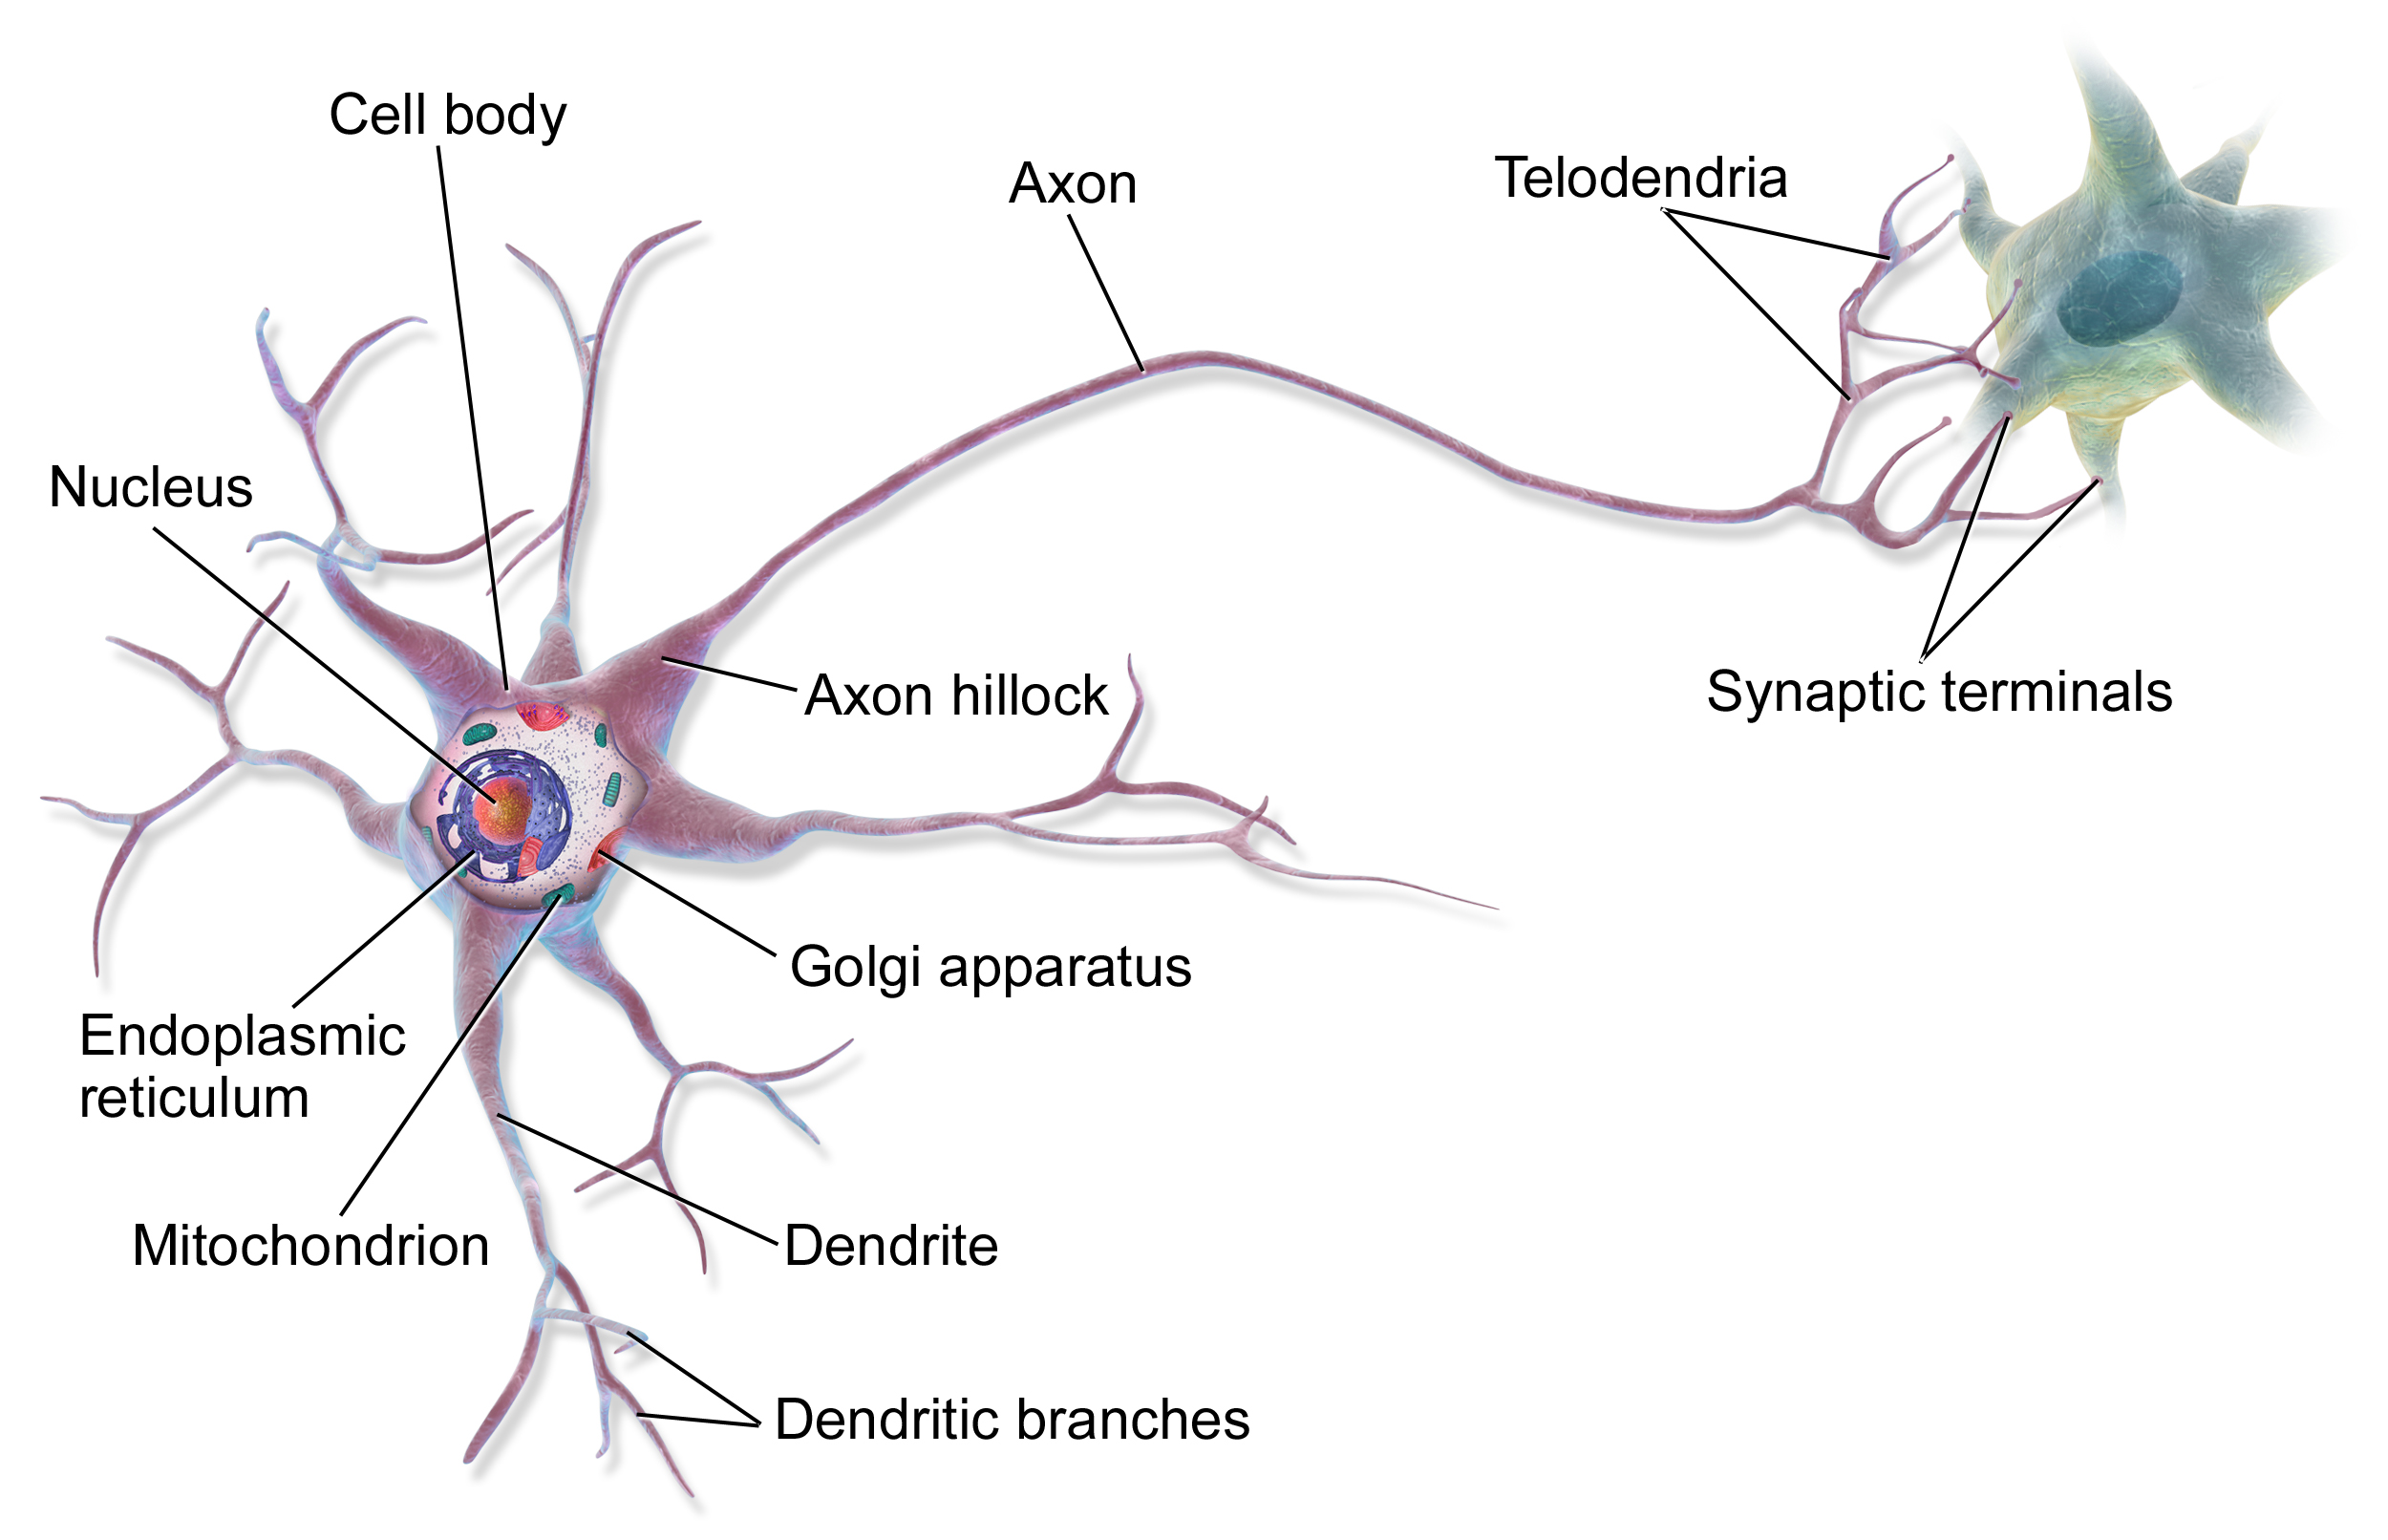
Biological Inspiration For Neural Networks
Human Brain: 86 Billion Neurons Processing Reality
Neuron Signal Flow:
Dendrites: Receive 1,000s of input signals from other neurons .
Cell Body (Soma): Integrates weighted inputs (∑w×x > threshold) .
Axon: Fires output spike to 1,000s of downstream neurons.
Learning Through Experiences: AI Neuron Translation:
Frequent use → Stronger synapses (Hebb's Rule)
"Weak connection" ──→ "Thick pathway"
Practice strengthens → Memories form → Skills improve.
Why Copy 500M Years of Evolution?
20 Watts processes vision/speech/language.
Hierarchical mastery: Edges → faces → emotions → context.
Fault tolerant: Billions of parallel pathways.
Our Brain uses 20-25W of Energy which is roughly equivalent to dim light bulb on a sleep mode.
Biology | Artificial Neural Network
Dendrites | Inputs (x₁= pixel brightness, x₂= edge strength)
Synapses | Weights (w₁=0.7 important, w₂=0.2 less important)
Cell Body | z = w₁x₁ + w₂x₂ + b (weighted decision)
Axon | y = f(z) (neuron "fires" or not) wikipedia

Slide 13
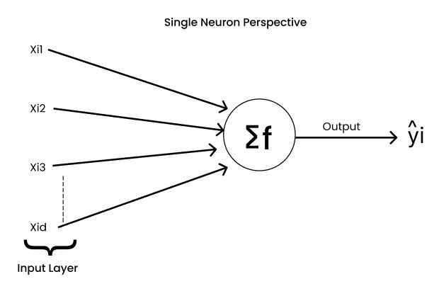
The Perceptron: First Step
Introduced: 1958 by Frank Rosenblatt.
Concept: A single neuron model inspired by biology.
Components:
Inputs: Data features.
Weights: Connection strengths.
Bias: Adjusts decision threshold.
Function: Computes weighted sum, applies activation for output.
Significance: Sparked AI by showing machines could learn patterns.

Slide 14
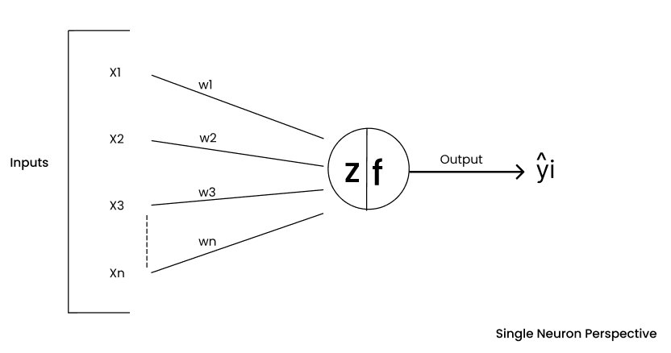
Mathematical Neuron Model
Equation:
Z = (w1 * x1 + w2 * x2 + ... + wd * xd) + b
w: Weights (feature importance).
x: Inputs (data features).
b: Bias (decision offset).
Activation: Output = F(Z), where F is the activation function.
Goal: Adjust weights and bias to minimize errors.

Slide 15
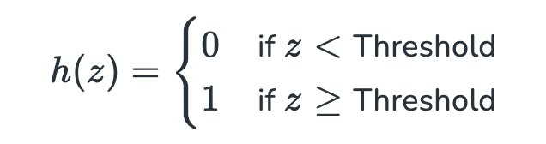
Step Function as Activation
Definition: Output = 1 if Z ≥ threshold; else 0.
Behavior: Binary (on/off), mimicking neuron firing.
Analogy: Light switch fully on or off.
Role: Used in early perceptrons for simple classification.

Slide 16

Limitations of the Step Function
Issues:
Non-differentiable: Prevents gradient-based learning.
Binary output: No nuances (e.g., probabilities).
Linear only: Fails on non-linear problems like XOR.
Impact: Limited perceptrons to simple tasks (e.g., AND/OR, not XOR).
Solution: Multi-layer networks with differentiable activations.

Slide 17
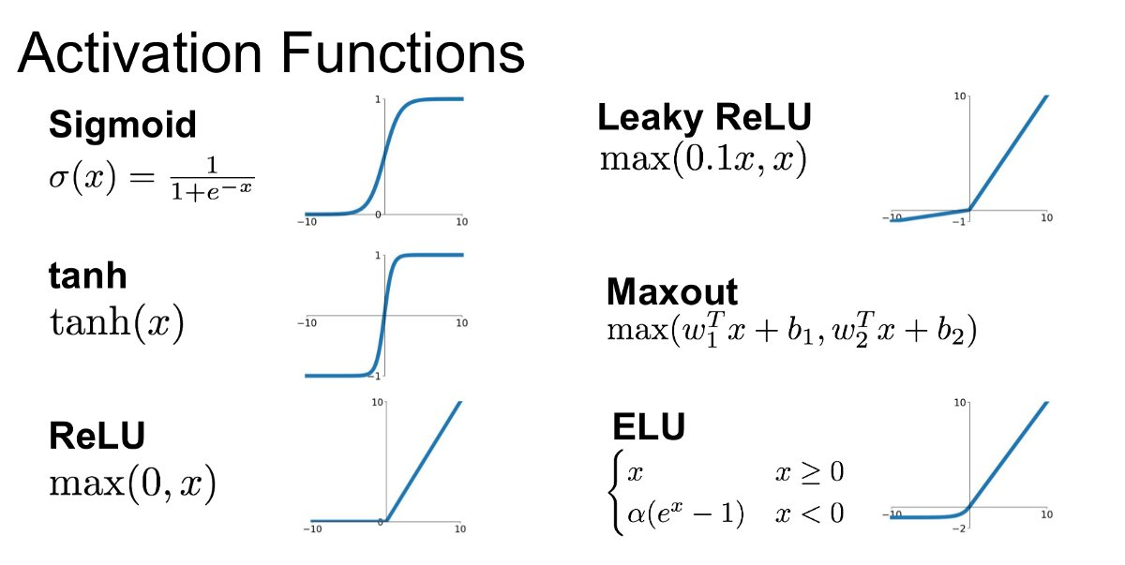
Activation Functions : Decision Makers
Role: Decide neuron output after weighted sum + bias.
Purposes:
Add non-linearity for complex modeling.
Control output range (e.g., 0-1 for probabilities).
Enable backpropagation via differentiability.
Types: Sigmoid, Tanh, ReLU(Rectified Linear Unit).
Analogy: Gates controlling information flow.

Slide 18
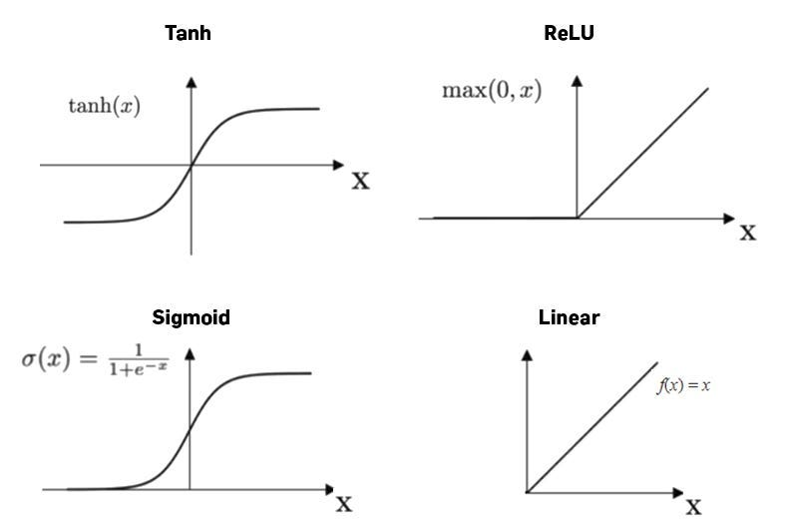
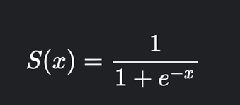
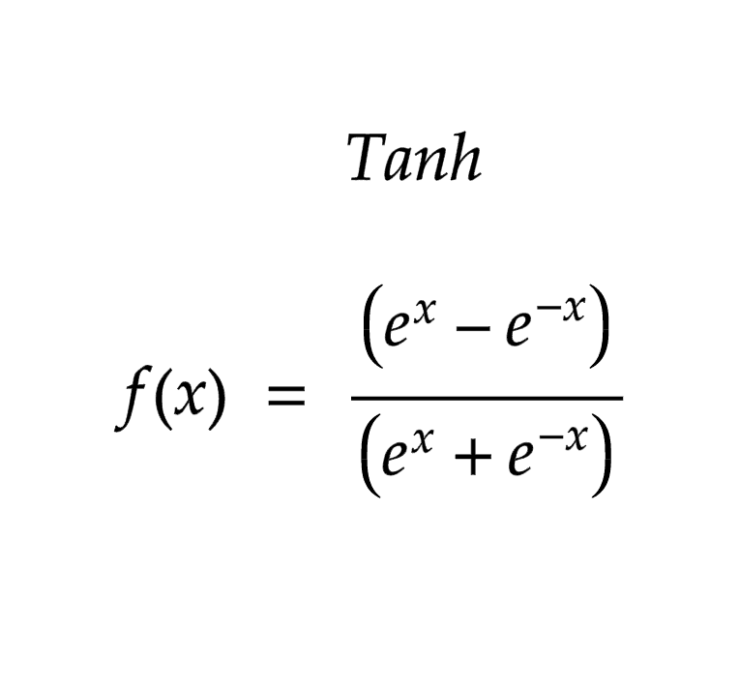
Activation Function Evolution : The Journey: Step Function → Sigmoid → Tanh → ReLU
Step Function (Perceptron 1957)
f(z) = { 1 if z ≥ 0
{ 0 if z < 0
Why: Binary decision (fire/don't fire)
Problem: Not differentiable → No gradient descent possible
Sigmoid (1986 Backprop Era):
Range: 0 to 1 | Smooth & Differentiable
Why: First gradient-friendly activation for backpropagation
Fatal Flaw: Vanishing gradients (σ'(z) → 0 as |z| grows)
Tanh (1990s Improvement)
Range: -1 to 1 | Zero-centered (better convergence)
Why: Fixes sigmoid's non-zero centering
Still fails: Vanishing gradients persist in deep nets

Slide 19
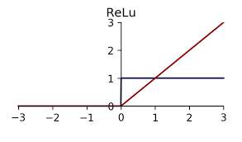
ReLU (Rectified Linear Unit)
Formula: ReLU(x) = max(0, x).
Behavior: Outputs x if positive; 0 if negative.
Advantages:
Fast and simple.
Avoids vanishing gradients (unlike sigmoid).
Promotes sparsity (many zeros).
Gradient: 1 (x>0), 0 (x<0) | No saturation!
Deep Net Training:
Sigmoid/Tanh: Layer 1 gradient = 0.25 × Layer 2 gradient
10 layers → gradient = 0.25^10 = 10^{-7} → Learning stops!
ReLU: Layer 1 gradient = 1.0 × Layer 2 gradient
100 layers → gradient = 1.0 → Deep learning explodes!
Issue: “Dying ReLU” (neurons stuck at 0),mitigated by variants like Leaky ReLU.
Applications: Standard in deep learning(CNNs, Transformers).

Slide 20
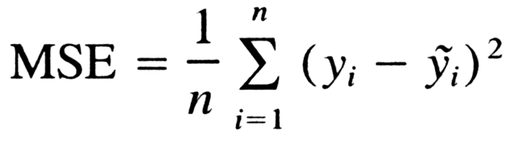


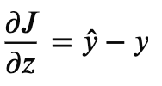
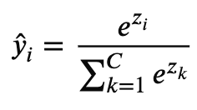

Loss Functions - MSE, BCE, Cross-Entropy
Measure prediction error to guide learning:
1. Mean Squared Error (MSE) - Regression.
Derivative:
Use when: Predicting continuous values (house prices, temperatures).
Why: Quadratic penalty → large errors hurt more.
Problem: Outliers dominate; assumes Gaussian noise.
2. Binary Cross-Entropy (BCE) - Binary Classification
Derivative:
Use when: 0/1 outcomes (spam/not spam, cat/not cat).
Why: Punishes confident wrong predictions brutally.
Gradient bonus: Clean y^−y (no saturation issues).
3. Categorical Cross-Entropy - Multi-Class
Derivative: (with soft max)
Use when: Multiple classes (ImageNet 1000 classes)
Magic: Logarithm + soft max → simplest gradient ever!
Task | Loss | Why
Regression | MSE | Continuous targets
Binary Class | BCE | 0/1 probabilities
Multi-Class | Cross-Entropy | Probability distributions
Never | MSE on classification | Gradients vanish when wrong!

Slide 21
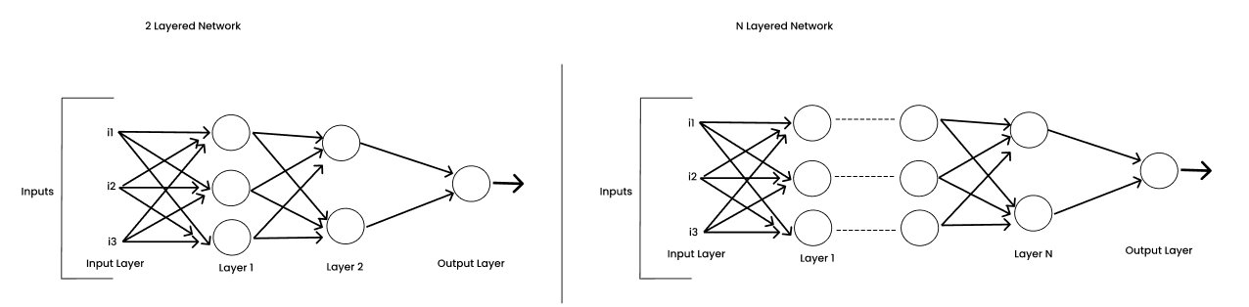
Perceptron to Multi Layered Perceptron
Perceptron Crisis: XOR Problem (1969)
XOR Truth Table (Single perceptron FAILS):
x1 x2 | Output
0 0 | 0 ← Linear boundary impossible
0 1 | 1
1 0 | 1
1 1 | 0
Single perceptron = straight line → Cannot solve XOR.
Multi-Layer Perceptron (MLP) Solution:
Input → Hidden Layer(s) → Output
x1 ──┐ │
x2 ──┼───[Nonlinear]──┼─── y
│ │
Bias─┘ └─[Nonlinear]
MLP Math (2 Hidden Neurons Solve XOR):
Hidden layer: h1 = ReLU(w11·x1 + w12·x2 + b1)
h2 = ReLU(w21·x1 + w22·x2 + b2)
Output: y = sigmoid(W1·h1 + W2·h2 + b_out)
Why Hidden Layers Work ?
Single Layer: f(x) = linear → w·x + b
Two Layers: f(x) = σ(W·σ(w·x + b) + B)
= COMPOSITION of nonlinear functions
→ Infinite expressiveness (Universal Approximation Theorem)
Feature | Perceptron (1957) | MLP (1986+)
Layers | Input → Output | Input → Hidden → Output
Decision Boundary | Straight line | Curved/Complex
XOR Solution | ❌ Impossible | ✅ Perfect
Training | Perceptron rule | Backpropagation
Real Tasks | Basic AND/OR | Images/Speech/Language

Slide 22
Backpropagation - The Learning Algorithm
How neural networks actually learn ?
Learning Representations through Back Propagating Errors (Rumelhart, Hinton, Williams 1986).
4-Step Training Cycle:
1. Forward Pass: x → Hidden → ŷ
2. Loss: L = (y - ŷ)²
3. Backward Pass: ∂L/∂w ← Chain Rule Magic
4. Update: w = w - η × ∂L/∂w
Chain Rule Makes It Possible: Why Backprop Revolutionized AI::
Loss L depends on output ŷ
ŷ depends on z2 = W2·h + b2
h depends on z1 = W1·x + b1
∂L/∂W1 = ∂L/∂ŷ × ∂ŷ/∂z2 × ∂z2/∂h × ∂h/∂z1 × ∂z1/∂W1
 | Before | After
 | Manual weight tweaking | Automatic gradient computation
 | 2-3 layers max | 100s of layers
 | Days of computation | Seconds per batch

Slide 23
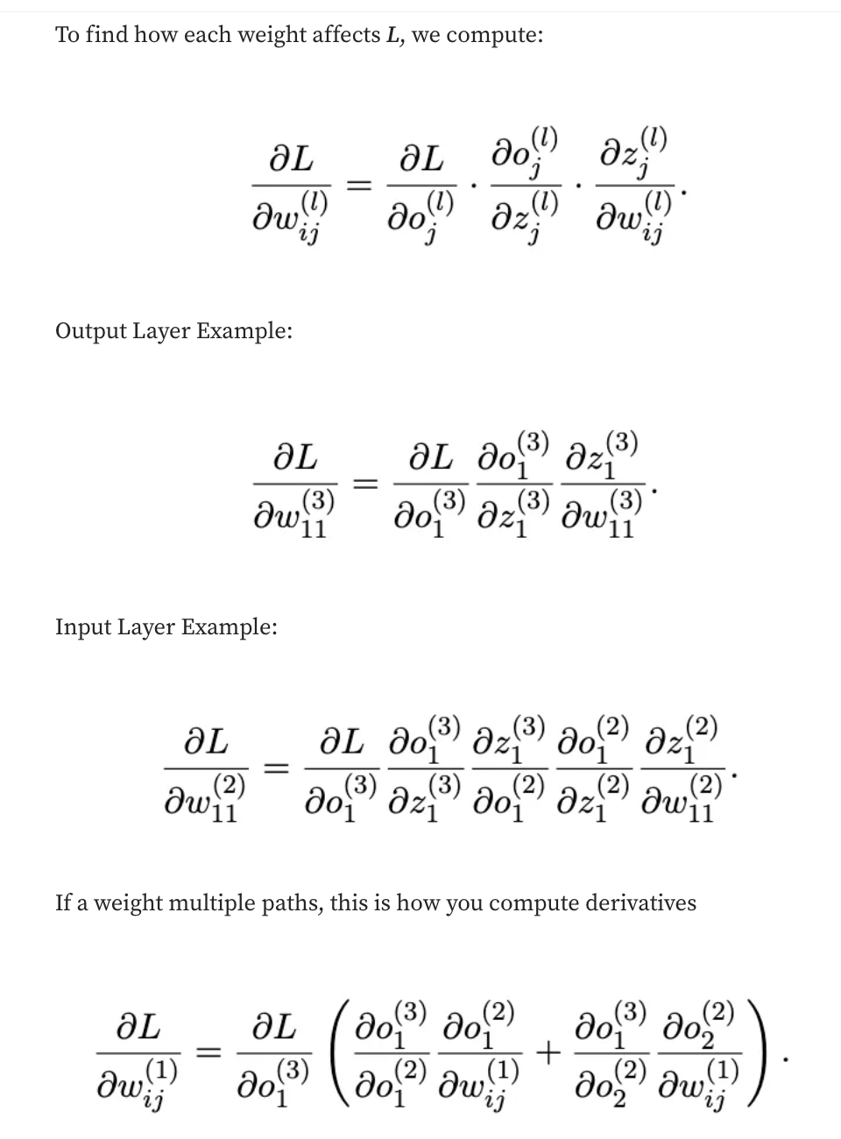
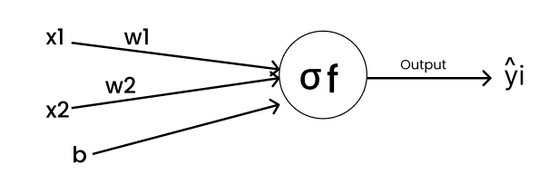
Back Propagation Example
Binary Classification
Inputs: [x1, x2] = [0.5, 0.3];
Weights: [W1, W2] = [0.15,0.20];
Bias, b= 0.35; Learning Rate, n = 0.5; Actual Output y = 1
Forward Pass:
z= x1w1 + x2w2 + b
z = (0.15)(0.5) + (0.20)(0.3) + 0.35
z = 0.075 + 0.06 + 0.35
z = 0.485
Sigmoid Activation
F(z) = 1 + 1/ e^(-z) = 1 + 1/e^(-0.485) = ~0.619
Prediction ==> ŷ ≈ 0.619; Target ==> y = 1
Loss Function
L = ½(y - ŷ)²
L = ½(1 - 0.619)² ==> L = 0.0726.

Slide 24
Back Prop : Numerical Example
Compute Error Signal (δ): Backprop begins by computing the error signal.
Chain rule
∂L/∂z = ∂L/∂ŷ · ∂ŷ/∂z
Derivative of loss:
∂L/∂ŷ = (ŷ - y) => = 0.619 - 1 = = -0.381.
Derivative of sigmoid
∂ŷ/∂z = ŷ(1-ŷ) => = 0.2358
Error Signal (δ)
Now compute
δ = ∂L/∂z; δ = (ŷ - y) · ŷ(1-ŷ);
δ = (-0.381)(0.2358) ==> δ = -0.0898.
Gradients for Weights:
z = w1x1 + w2x2 + b
Therefore
∂z/∂w1 = x1 ; ∂z/∂w2 = x2
Using chain rule
∂L/∂w1 = δ · x1
∂L/∂w2 = δ · x2

Slide 25
Back Prop : Weight Updates
Gradient for w1
∂L/∂w1 = (-0.0898)(0.5) = -0.0449
Gradient for w2
∂L/∂w2 = (-0.0898)(0.3) = -0.0269
Gradient for Bias
∂L/∂b = δ = -0.0898
Weight Updates
Gradient Descent update rule
w_new = w - η ∂L/∂w
Learning rate; η = 0.5
Update w1
w1_new = 0.15 - 0.5(-0.0449)
w1_new = 0.15 + 0.02245 = 0.17245
Update w2
w2_new = 0.20 - 0.5(-0.0269)
w2_new = 0.20 + 0.01345 = 0.21345
Update Bias
b_new = 0.35 - 0.5(-0.0898)
b_new = 0.35 + 0.0449 = 0.3949

